Slide 1

Institute of Aeronautical Engineering (IARE) (Autonomous Institute NAAC Accrediation with “A” Grade Accredited by NBA Affiliation Statusw from JNTUH) DEPARTMENT OF ELECTRICAL AND ELECTRONICS ENGINEERING
A
Project Report
on
“Transmission Line Fault Detection Using Android Application
Via Bluetooth ”

Slide 2
ABSTRACT
Technological advancement and its incorporation is playing significant in human life. In
present days, the demand on the electric power for the household, commercial and industrial
loads is increasing. Also, the management of electric power distribution system is becoming
more complex. Bluetooth based fault detection is a newly developing concept in the power
system fault detection. This is a part of smart grid. The system is designed to detect the
transmission line fault for the user to easily recognize the current condition of the distribution line.
The ultimate objective is to monitor the distribution line status continuously and hence to guard
the fault of distribution line due to the constraints such as overvoltage, under voltage, SLG, DLG
faults. If any of these does occurs then a user can easily detect the fault.

Slide 3
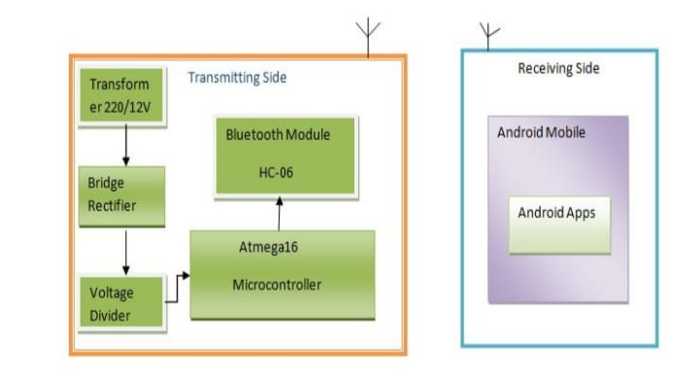
BLOCK DIAGRAM
COMPONENTS
1.TRANSFORMERS
2.BRIDGE RECTIFIER
3.8052 MICROCONTROLLER
4.BLUETOOTH MODULE
5.ANDROID APPLICATION APP

Slide 4
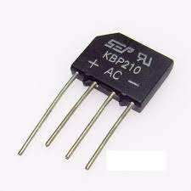
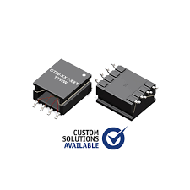
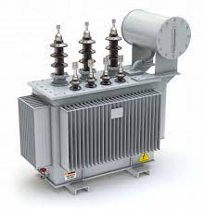

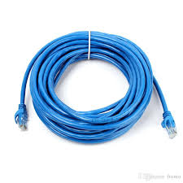

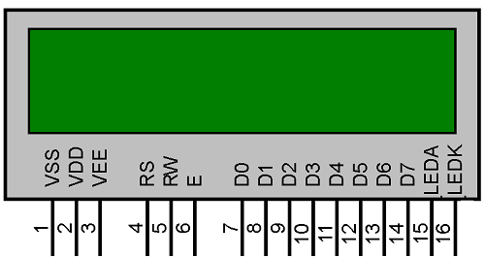
COMPONENTS
Bridge Rectifier
ICE (Integrated Circuit)
Transformer
Android application
Connecting wires
Bluetooth Module
Microcontroller(8052)

Slide 5
INTRODUCTION
Protection system’s main function is to clear faults from the power system at high speed to ensure safety, minimize equipment damage and maintain power system stability[2]. Protection of power systems requires an understanding of system faults, their detection, and safe isolation of the faulted device. By taking an inventory of all the essential electrical loads and doing a basic electrical load evaluation [2], an idea regarding how much power our system needs to produce has been obtained.
We are also aware about the power fluctuation situations also that means what voltage minimum / maximum we are getting from the A.C supply mains. In doing this project we would be using concepts of microcontrollers, Bluetooth Module and Android Application.

Slide 6
TYPES OF FAULT
Single line-to-ground fault.
Double line-to-ground fault.
Line-to-line fault.
Lower voltage fault.
Over voltage fault.

Slide 7
HARDWARE IMPLEMENTATION
In reference to figure 4, the transmitting and receiving side can be described as follows: 1.Transmitting side: Heart of the project is the microcontroller ATMEGA 16. In general the normal distribution phase voltage is 220 V, in this project we used a step down transformer 220/12 V for converting the phase voltage from 220 V to 12 V. Then, a bridge rectifier has beenused for converting the 12 V ac to 12 V dc; after that, applied voltage divider converts the 12 V to 5 V because the microcontroller works at maximum 5 V. By this Process the three distribution phase is connected into three microcontroller pins. At cases, when the distribution side is in load shedding protection of transformer must be ensured, which is why the microcontroller power is given from an external power source (5 V battery) backup and also the Bluetooth module power is given from external power source(4V battery). Bluetooth module communicates with atmeg16 through UART. RXD of Bluetooth module is connected with TXD of atmega16 and TXD of Bluetooth module is connected to RXD of atmega16.
2.Receiving side:
In receiver Side an Android Phone is connected with Transmitting side via Bluetooth Module CI Android Apps[6]. At first we connect the android phone with 06 and the password of the HC-06 is 1234 then android The communication protocol is UART and baud rate is apps shows the data which is send by transmitting side. 9600[4].

Slide 8
FUTURE PROSPECTS
In view of a wide and Short range of possibilities on the basis of Bluetooth based fault Detection system,a few has been depicted below:
1. Fault detection of a Generator and motor.
2. Improvements to human-machine interface.
3. Improvements in computer-based protection of Indu stry automation.

Slide 9
ADVANTAGES
Devices are enable by wireless communication.
Coverage area is large compared to existing system.
Less number of components and manual obsevartion. so it is economically reliable and lowcost.

Slide 10
APPLICATIONS
Used in transmission line.
Used in textile mills.
Used infood industry.

Slide 11
CONCLUSION
Microcontroller and Bluetooth based fault detection system is a reliable technique for monitoring and controlling the electric distribution system, the microcontroller works up to 100 ⁰C temperature. For Short distance data transmission Bluetooth technology is a reliable and robust one. Any kind of fault occurring in the distribution system results the Bluetooth modules to send instant messages automatically to the nearest user. Bluetooth based microcontroller Fault detection system will serve as a reliable, easy and cost effective solution for monitoring and controlling the electric distribution system.

Slide 12
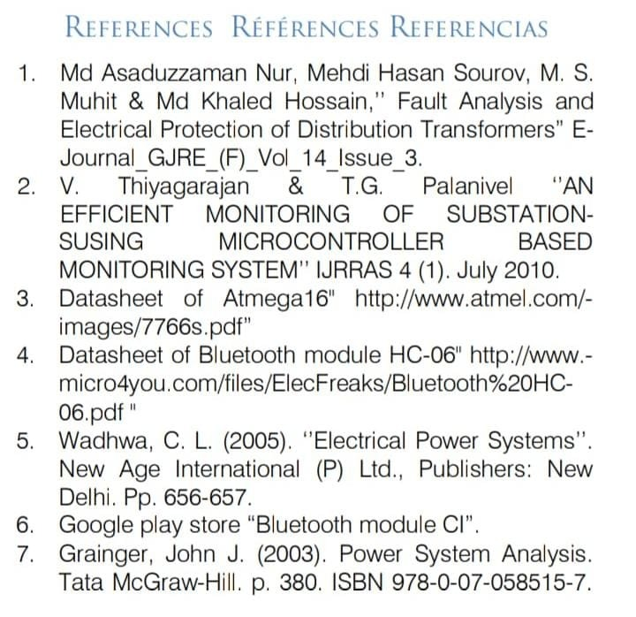

Slide 13
THANK YOU
ALL

